Slide 1
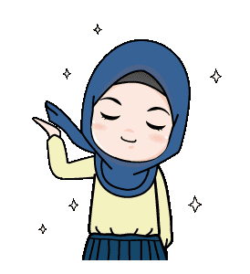

ALL ABOUT MYSELF
BY AREEBA ZEESHAN

Slide 2
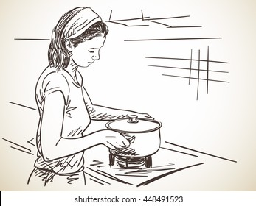
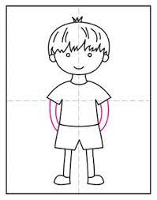

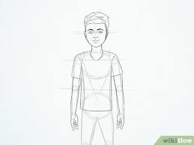
MOTHER: SANA ZEESHAN
HOUSEWIFE
CARING AND LOVING
YOUNGEST SIBLING
7 YEAR OLD
2ND GRADE STUDENT
STUBBORN YET EVERYONES FAVOURITE
FATHER; ZEESHAN IQBAL
BUSINESS MAN
A GREAT FATHER
BROTHER: ABDULLAH ZEESHAN
16 YEAR OLD
10TH GRADE STUDENT
EXTREMELY ANNOYING BUT SWEET

Slide 3

AND THAT'S ME
ELDEST AND THE ONLY DAUGHTER
20 YEARS OLD
1ST YEAR BBA STUDENT
A QUIET ANDHARDWORKING INDIVIDUAL
BORN AND RAISED IN KARACHI

Slide 4
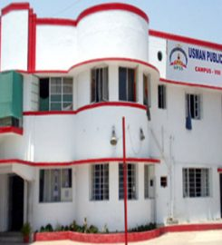
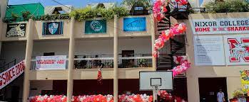
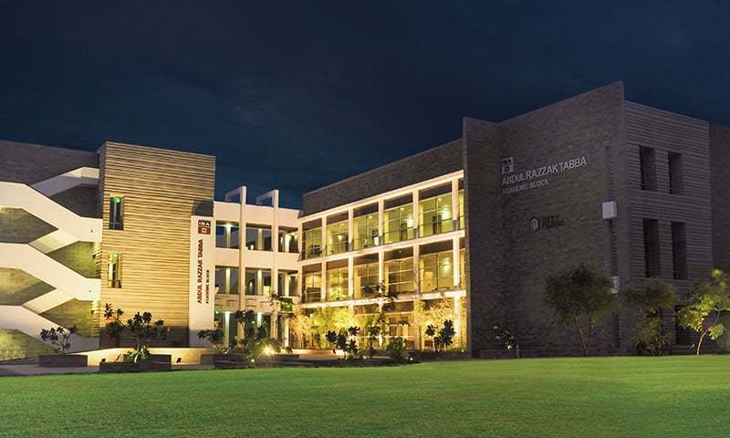
EDUCATION
USMAN PUBLIC SCHOOL
CLASS OF 2019
MAJOR: SCIENCE
NIXOR COLLEGE
CLASS OF 2021
MIXED COMNINATION OF SUBJECTS: BUSINESS,SOCIOLOGY AND MATHS
IBA
CLASS OF 2025
BBA

Slide 5
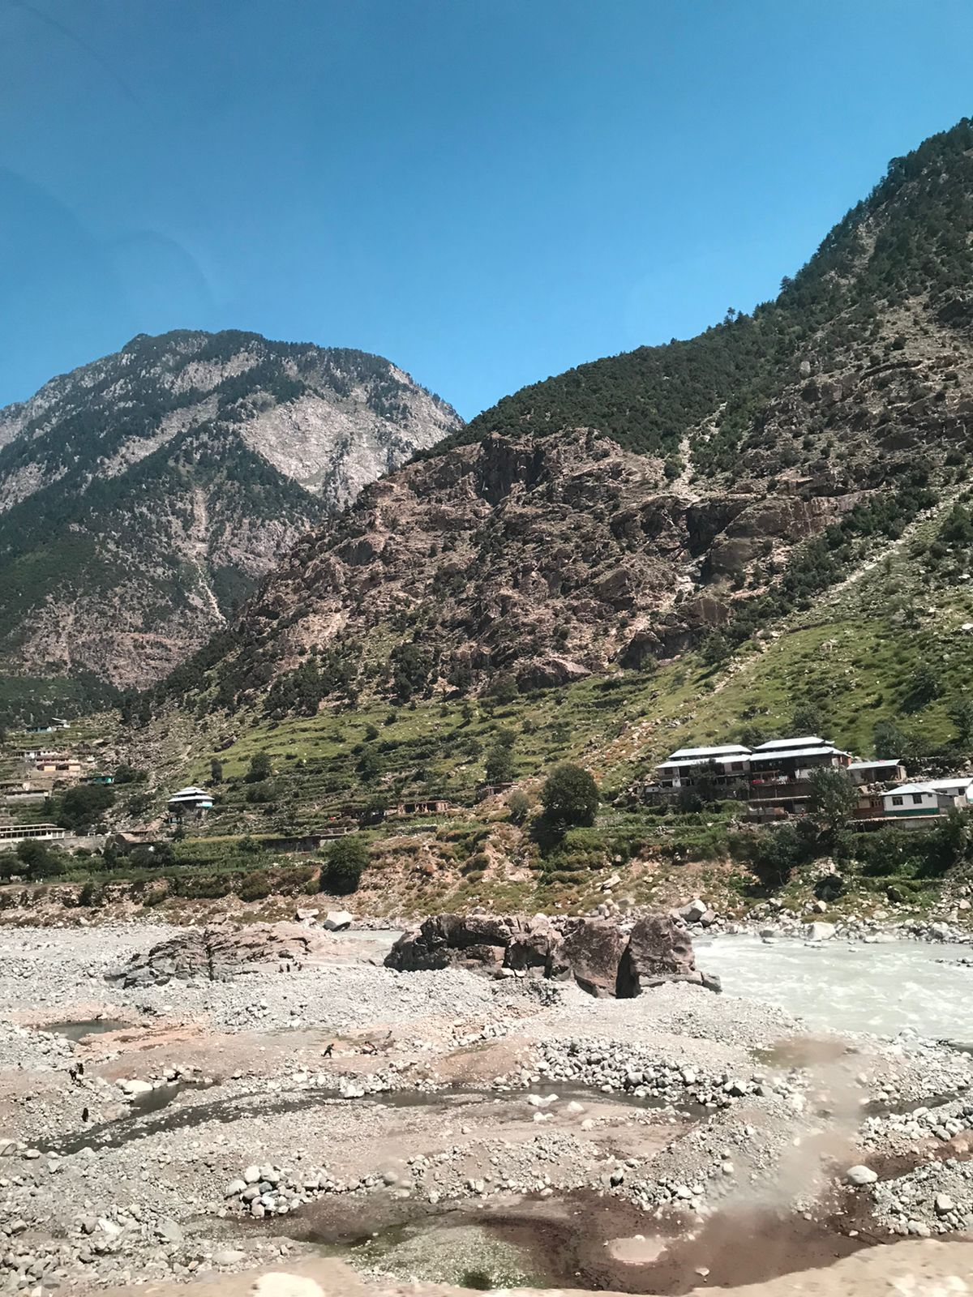
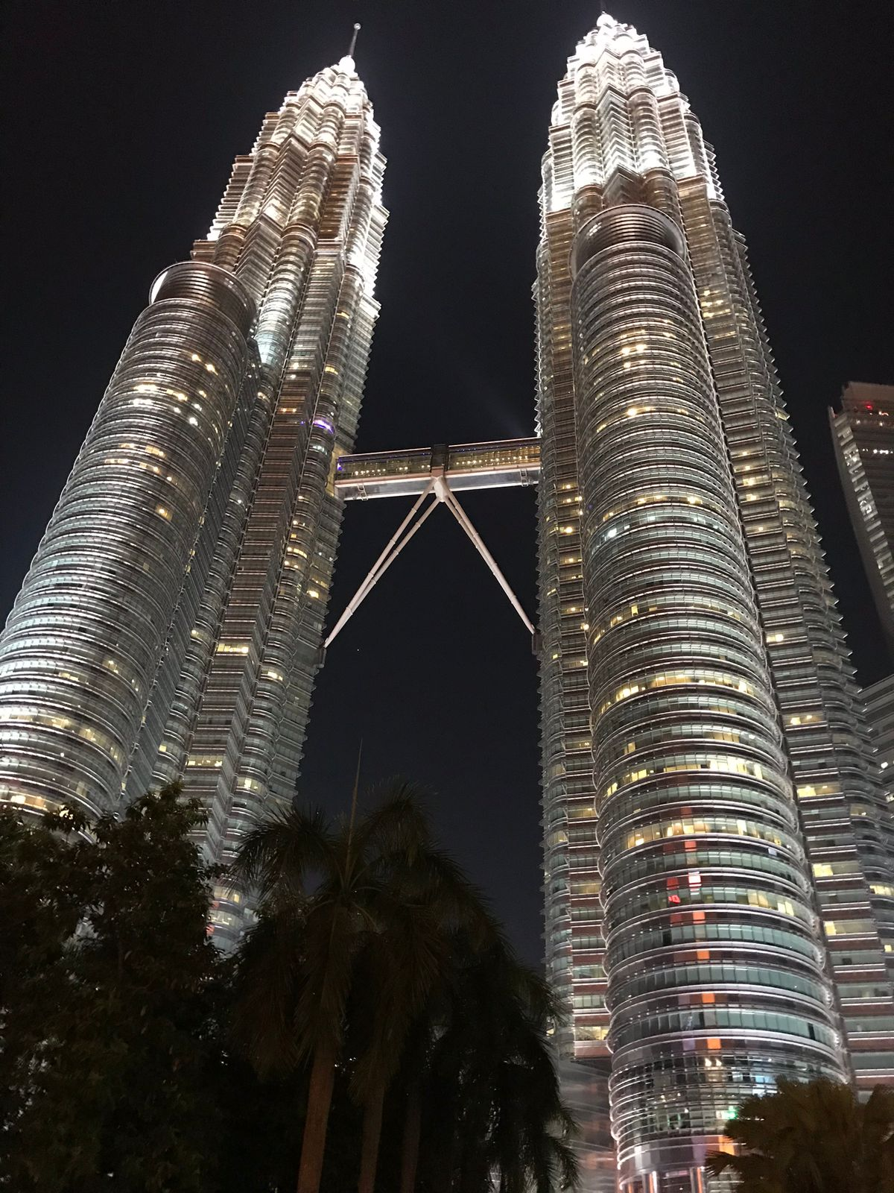
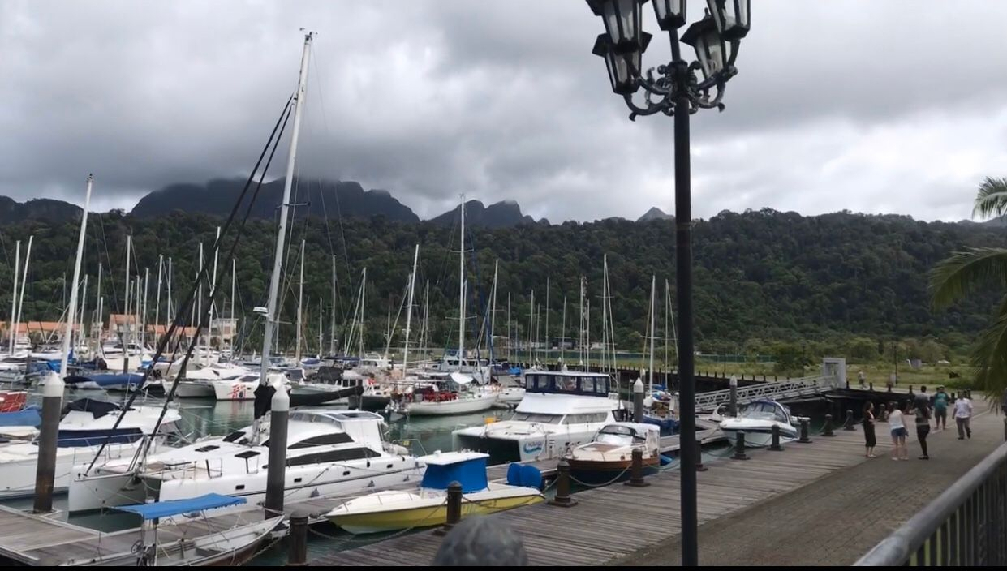
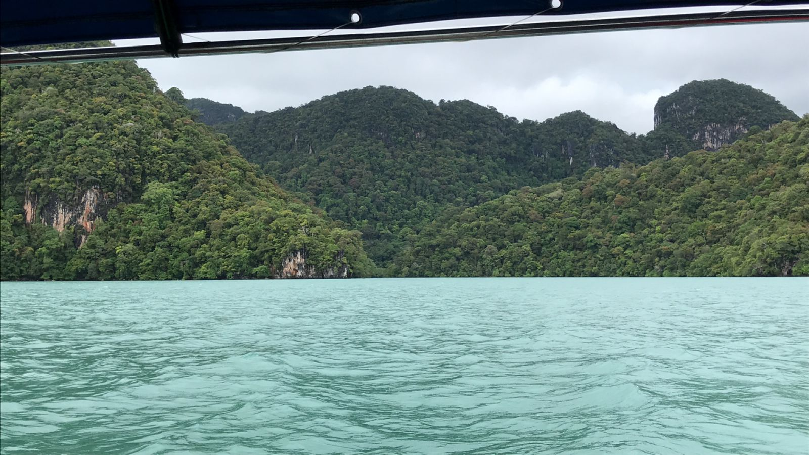
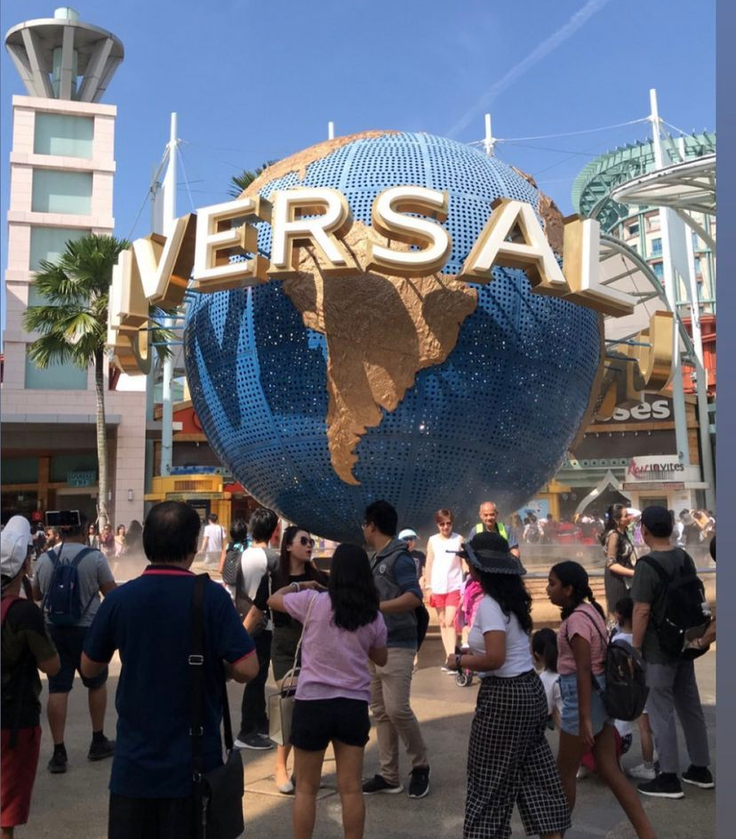
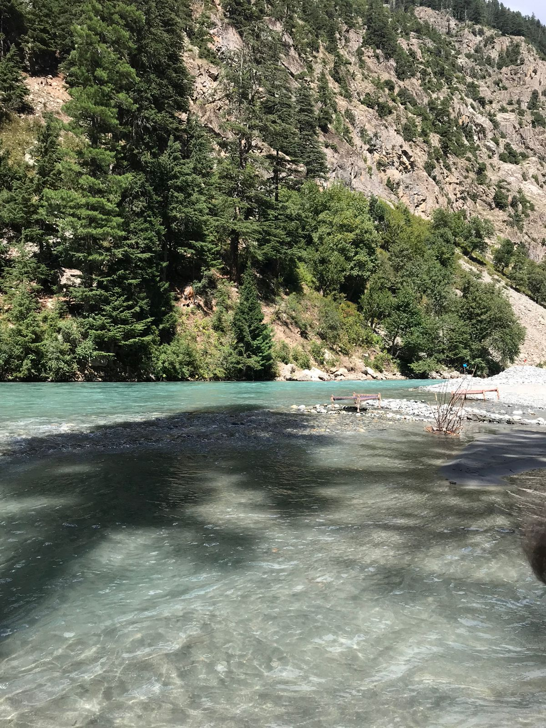
TRAVEL EXPERIENCES
PAKISTAN
MALAYSIA
SINGAPORE

Slide 6
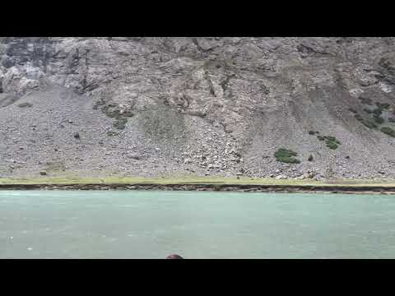
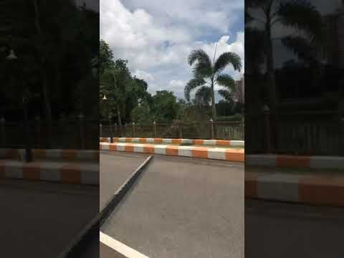
BEAUTY THAT EVEN CAMERA FAILED TO CAPTURE PERFECTLY

Slide 7
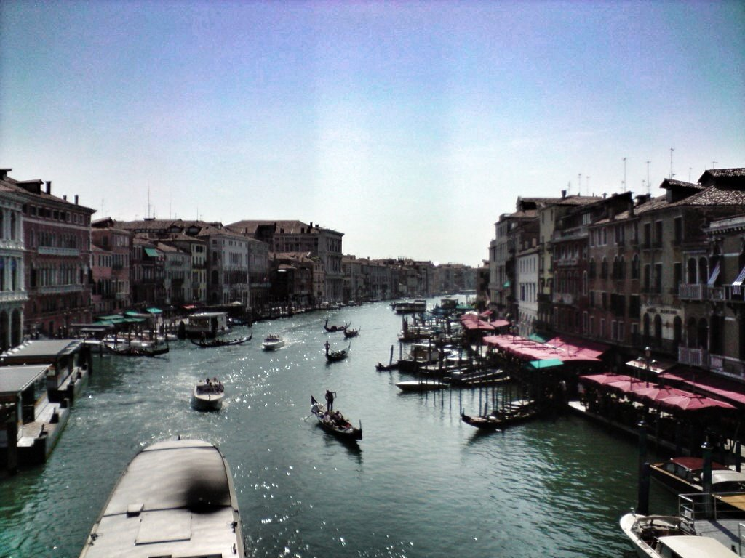

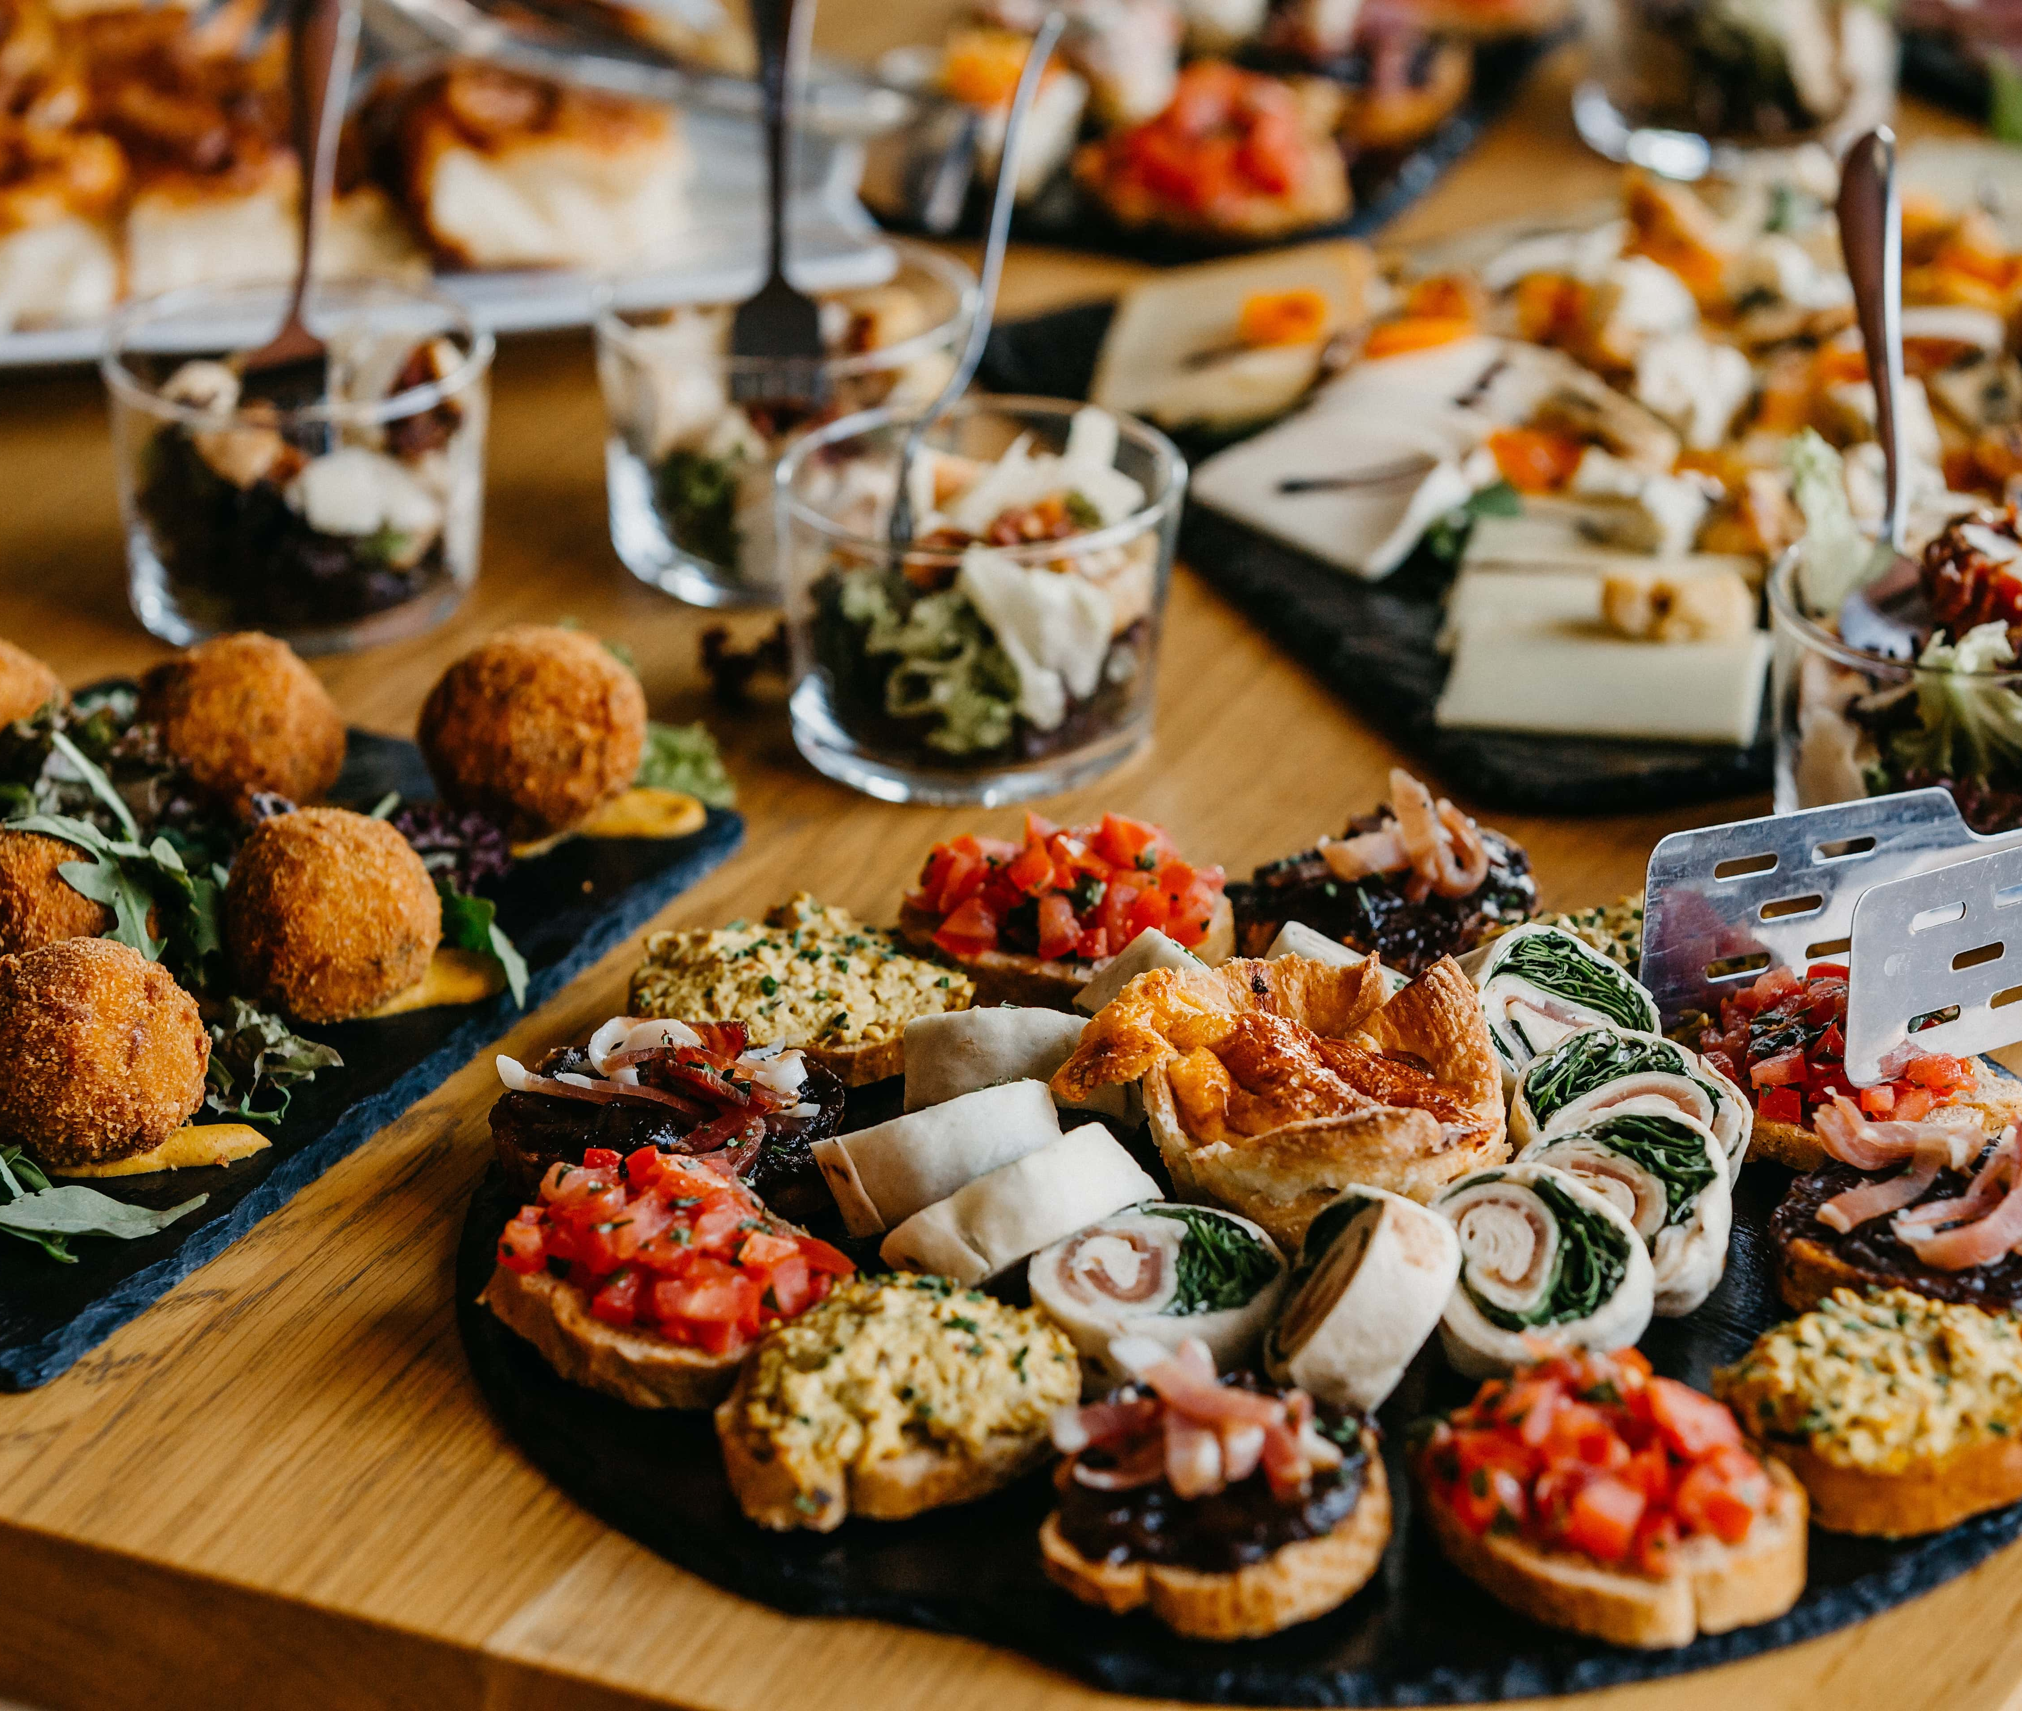
THINGS I LIKE:
FOOD
TRAVELLING
WATCHING TV SHOWS
SPENDING TIME WITH FAMILY
A-NC.

Slide 8
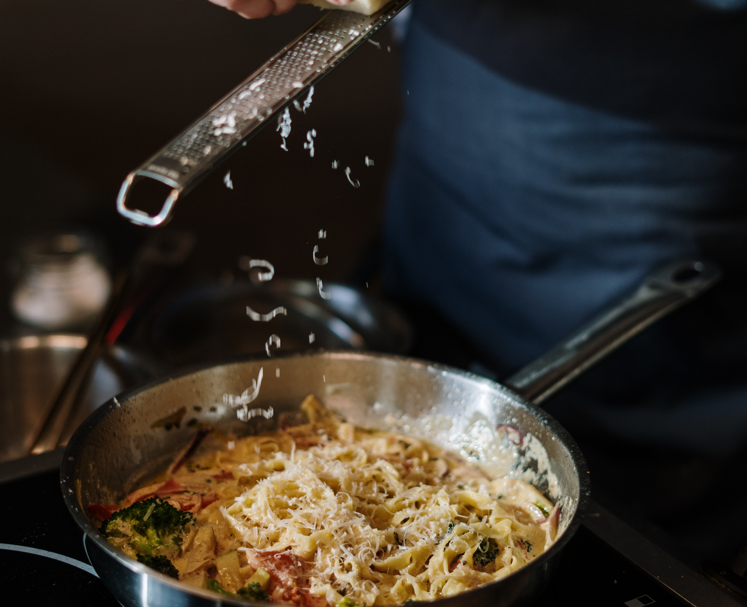

THINGS I AM NOT VERY FOND OF :
DOING HOUSE CHORES
BOREDOM
NOT VERY MUCH INTO READING BOOKS
BIG GATHETINGS

Slide 9
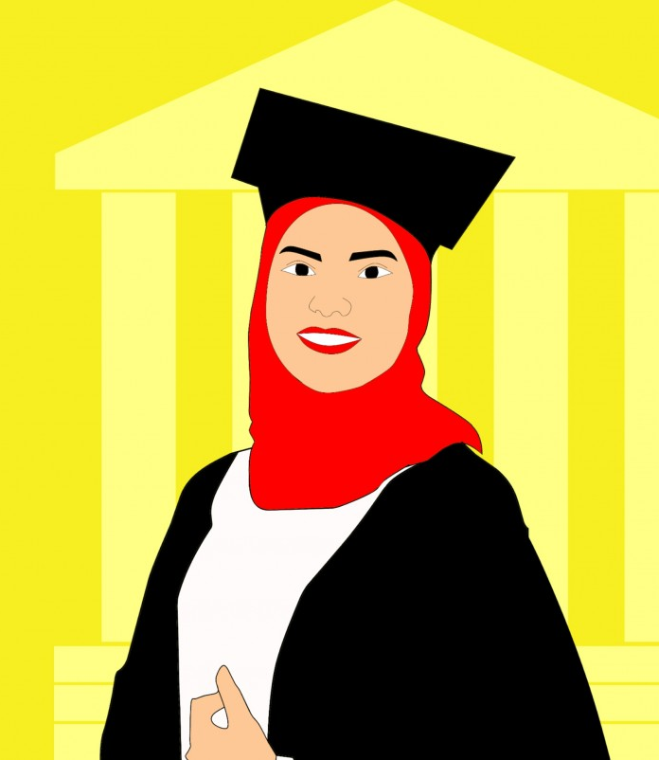
GOALS IN LIFE
I ALWAYS WANTED TO DO SOMETHING THAT OTHER GIRLS IN MY FAMILY COULDN’T DO,STUDYING IN A UNIVERISTY AND GETTING A DEGREE IS ONE OF THOSE THINGS.
HOWEVER,IN THE FUTURE, I PLAN TO DO CSS WHICH WAS INITIALLY MY FATHERS WISH BUT NOW HAS BECOME A GOAL OF MY LIFE AND I HOPE TO SUCCEED IN IT AND PROVE MYSELF.

Slide 10


